Slide 1
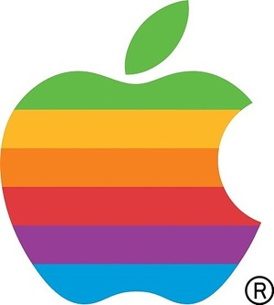
Apple Inc.
Paul Good
David Fabiszewski

Slide 2
Introduction
Apple was founded in April 1976.
As of July 2011 Apple had 364 retail store in 13 countries
Apple became a multi-national company in 1980
Apple Inc. is now worth over $500billion.

Slide 3
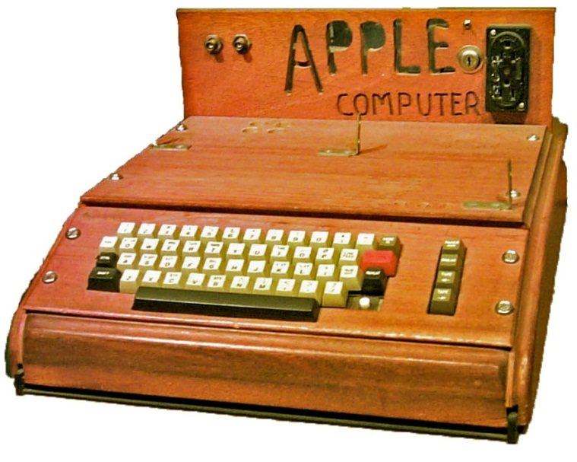
The Beginning…
The Apple 1 was Apples first computer and one of the worlds first PC.
It was hand built and was an extremely basic machine which took hours to programme to do the most basic of tasks.
Yet it was hugely popular from the beginning especially at the Homebrew computer club.

Slide 4

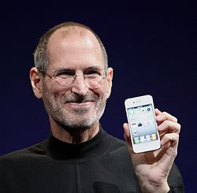

Founders
Steve Wozniak
Steve Jobs
Ronal Wayne
Is an American computer engineer and programmer who founded Apple Computer
He is best known as the co-founder, chairman, and chief executive officer of Apple Inc.
Is a retired American electronics industry worker. He founded Apple Computer with Steve Wozniak and Steve Jobs

Slide 5
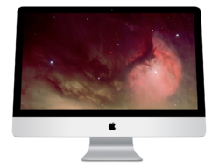
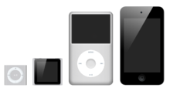
Mac & IPod
Different versions of Mac
IPod
Mac Mini, consumer sub-desktop computer and server introduced in 2005.
iMac, consumer all-in-one desktop computer introduced in 1998.
Mac Pro, workstation-class desktop computer introduced in 2006, replacing the Power Macintosh.
MacBook Pro, professional notebook introduced in 2006, replacing the PowerBook.
On October 23, 2001, Apple introduced the iPod digital music player
It has evolved to include various models targeting the wants of different users. The iPod is the market leader in portable music players by a significant margin, with more than 220 million units shipped as of September 2009

Slide 6
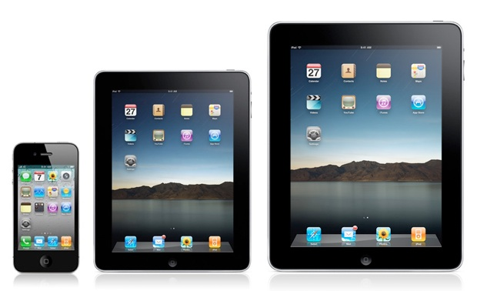
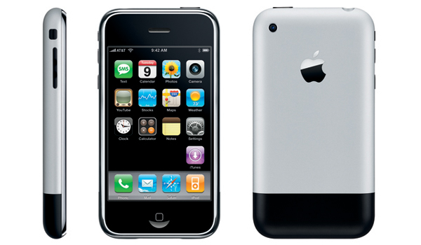
IPad & IPhone
On January 27, 2010, Apple introduced their much-anticipated media tablet, the iPad running a modified version of iOS. It offers multi-touch interaction with multimedia formats including newspapers, magazines, ebooks, textbooks, photos, movies, TV shows videos, music, word processing documents, spreadsheets, video games, and most existing iPhone apps.
At the Macworld Conference & Expo in January 2007, Steve Jobs revealed the long anticipated iPhone, a convergence of an Internet-enabled smartphone and iPod.

Slide 7

iTunes was introduced by Apple on January 9 2001.
It has been the most popular music vendor in the United States since April 2008, and the most popular music vendor in the world since February 24, 2010.
It now offers over 28 million songs, videos and apps and will generate $13 billion in revenues by 2013.

Slide 8
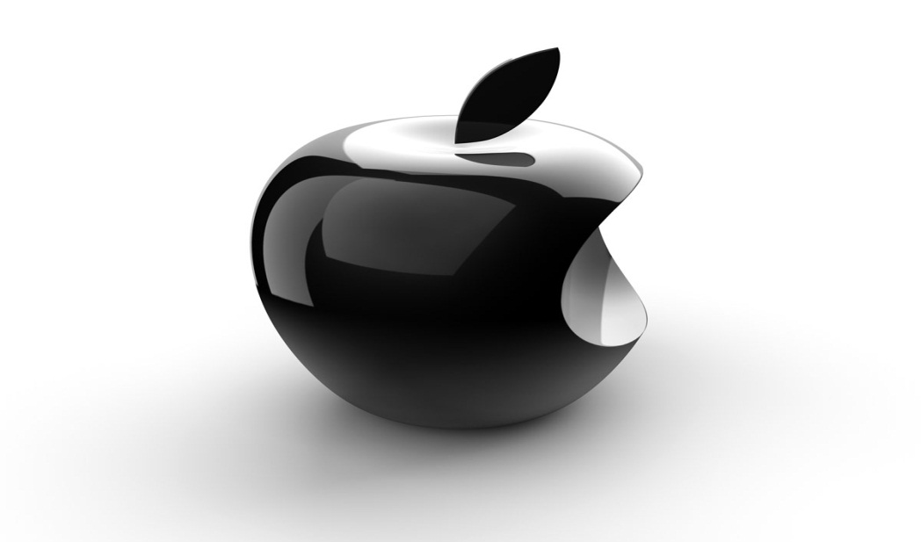
Widespread Success
Apple’s success can be put down to its continuous innovation.
Apple released the first personal computer, the apple 1 , the first consumer digital camera, the quicktake 100, and the first touchscreen phone, the iphone.
These innovations led to Apple to create revenues of over $100billion a year!

